Slide 1

PROJECT OVERVIEW
EASY
ADVANCED

Slide 2
PROJECT OVERVIEW
In this project, we will learn how to (1) label images for object detection by drawing bounding boxes, (2) to label text data to perform sentiment analysis, and (3) perform pixel level semantic segmentation using Amazon SageMaker GroundTruth.
These are the key learning outcomes:
Learn how to define a bounding box labeling job using Amazon SageMaker Groundtruth
Learn how to define a text labeling job using Amazon SageMaker Groundtruth
Learn how to define semantic segmentation labeling job using Amazon SageMaker Groundtruth
Perform text labeling job
Draw bounding boxes and pixel-level semantics in Amazon SageMaker Groundtruth

Slide 3
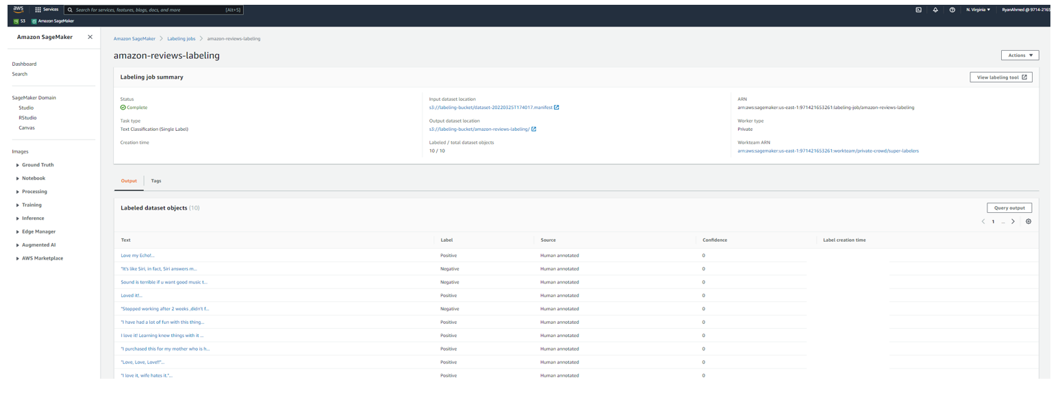
PROJECT OVERVIEW

Slide 4
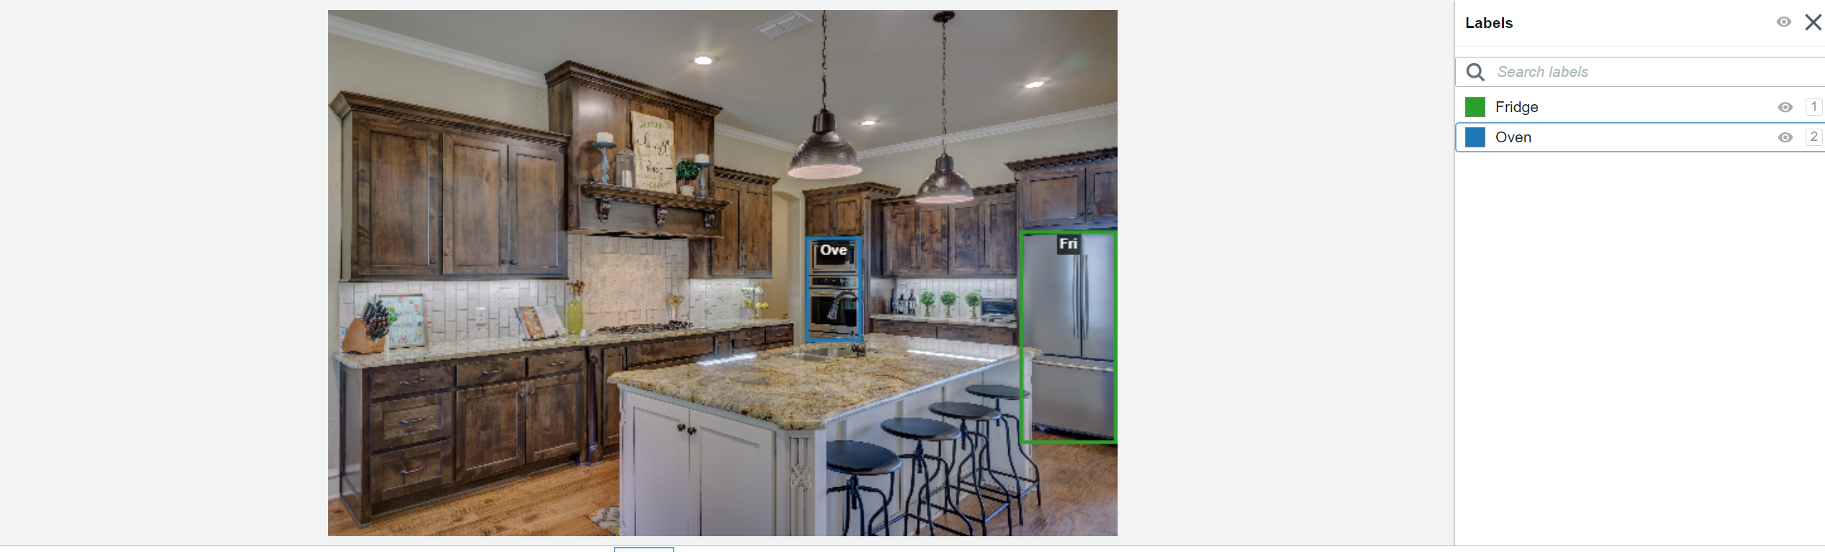
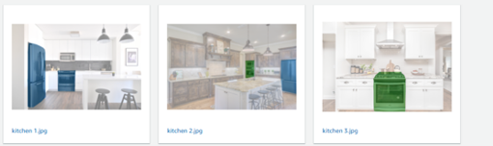
PROJECT OVERVIEW

Slide 5
LABELING TEXT DATASET
EASY
ADVANCED

Slide 6
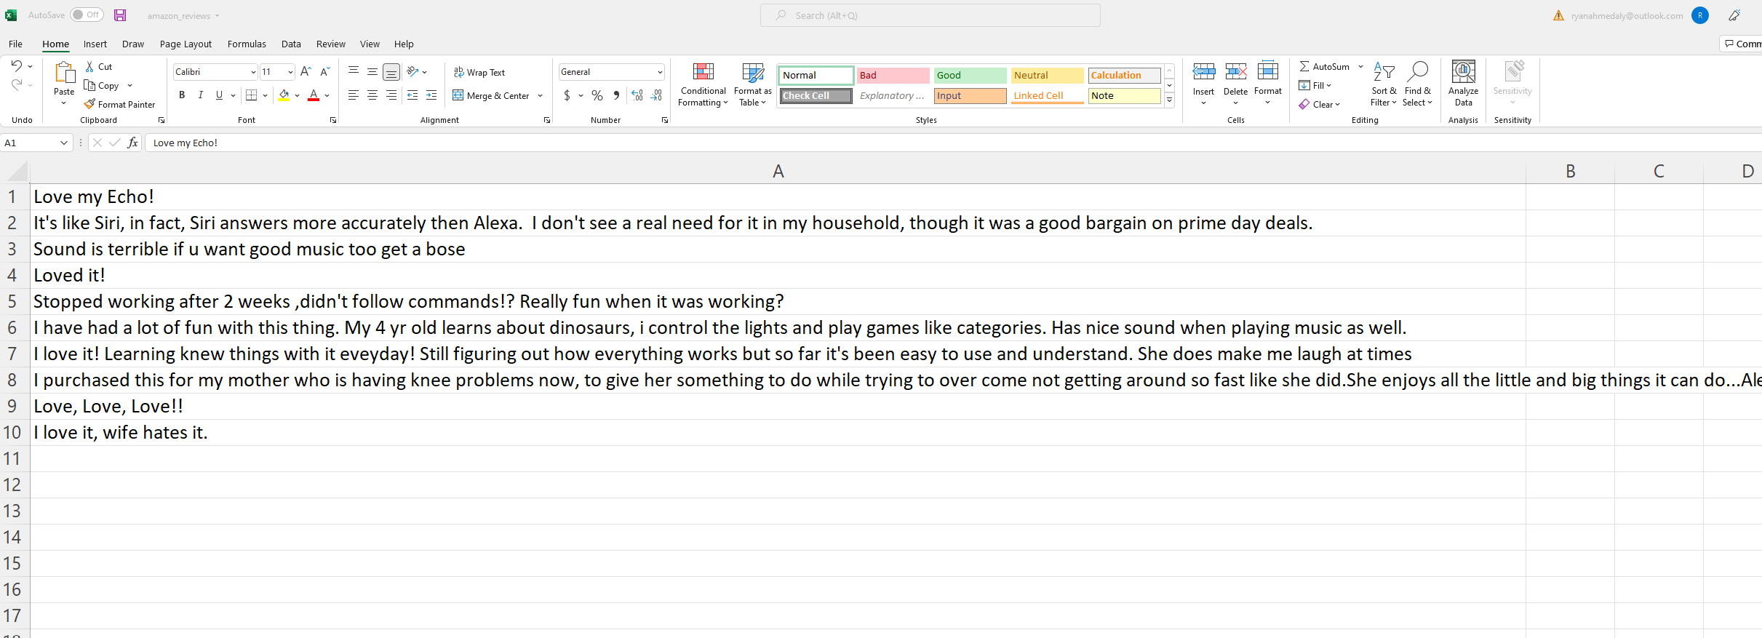
LABELING TEXT DATASET
THE OBJECTIVE IS TO LABEL THE FOLLOWING 10 REVIEWS TO EITHER POSITIVE OR NEGATIVE

Slide 7
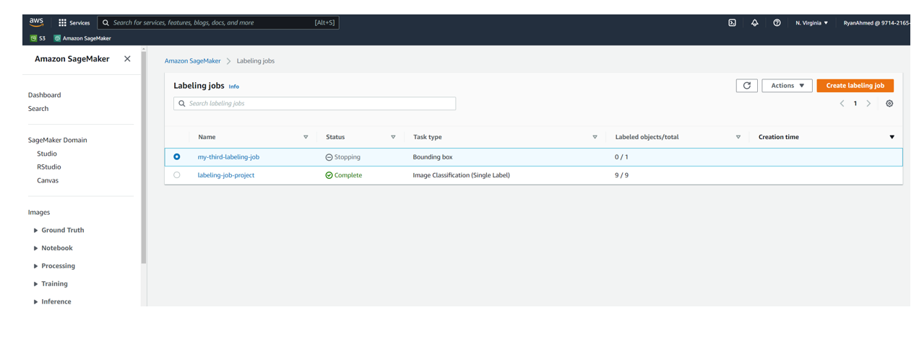
LABELING TEXT DATASET
NAVIGATE TO SAGEMAKER GROUNDTRUTH AND CLICK ON CREATE LABELING JOB

Slide 8
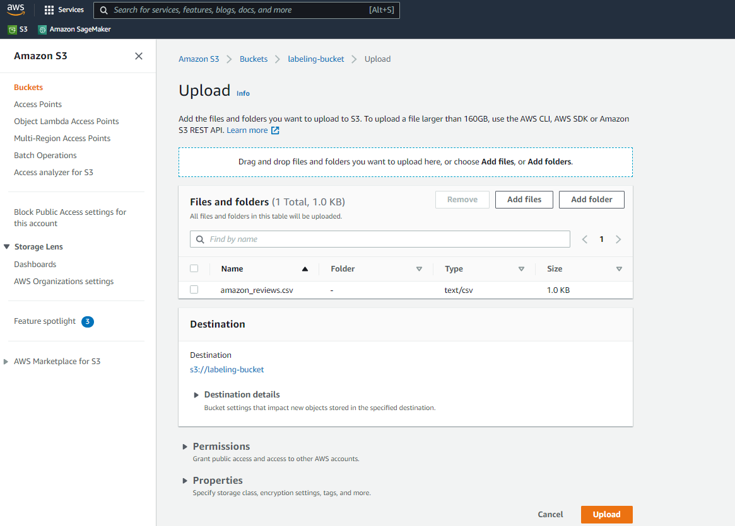
LABELING TEXT DATASET
UPLOAD AMAZON REVIEWS DATASET TO S3

Slide 9

LABELING TEXT DATASET
PROVIDE A NAME TO THE LABELING JOB, SELECT AUTOMATED DATA SETUP AND PROVIDE THE S3 PATH. CLICK ON COMPLETE DATA SETUP TO GENERATE THE INPUT MANIFEST FILE.

Slide 10
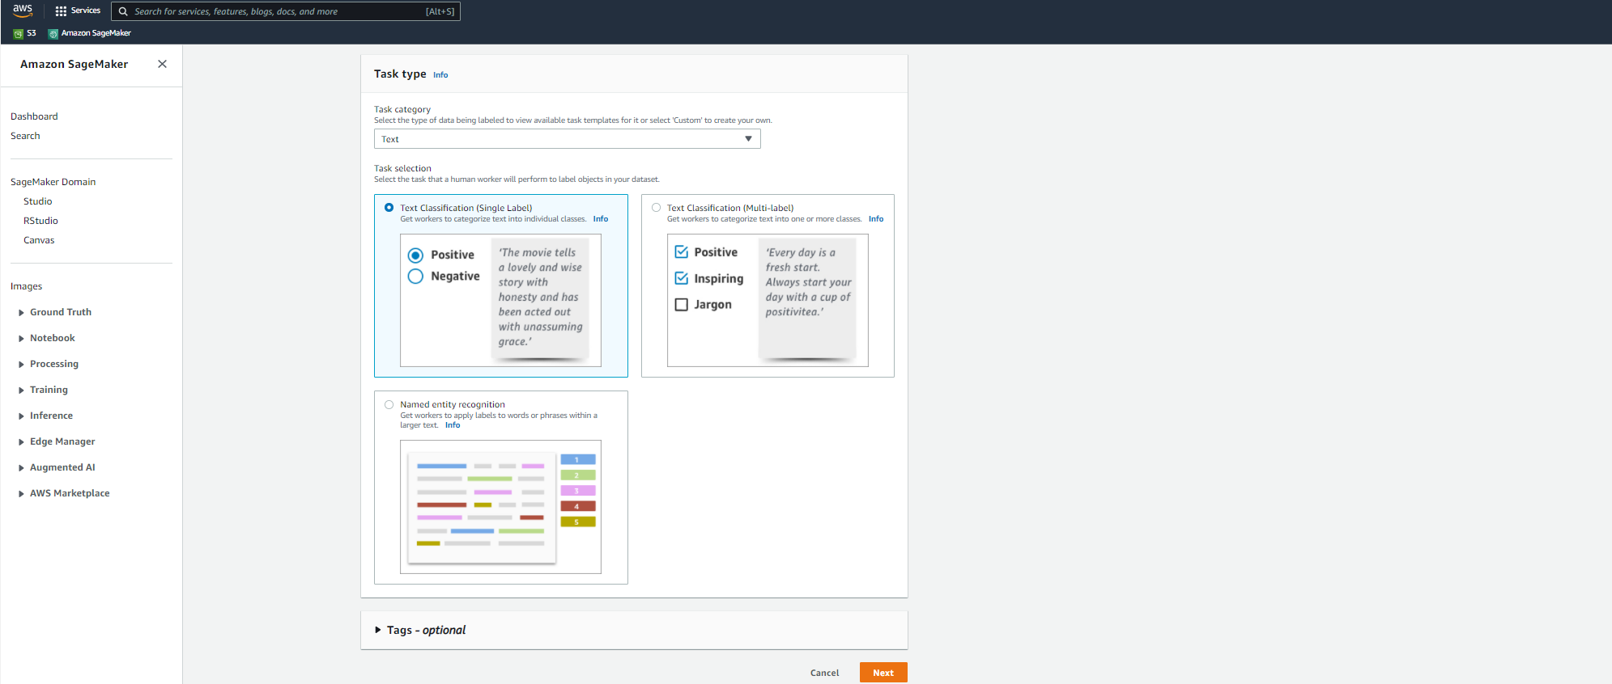
LABELING TEXT DATASET
SELECT TEXT AND TEXT CLASSIFICATION THEN CLICK NEXT

Slide 11
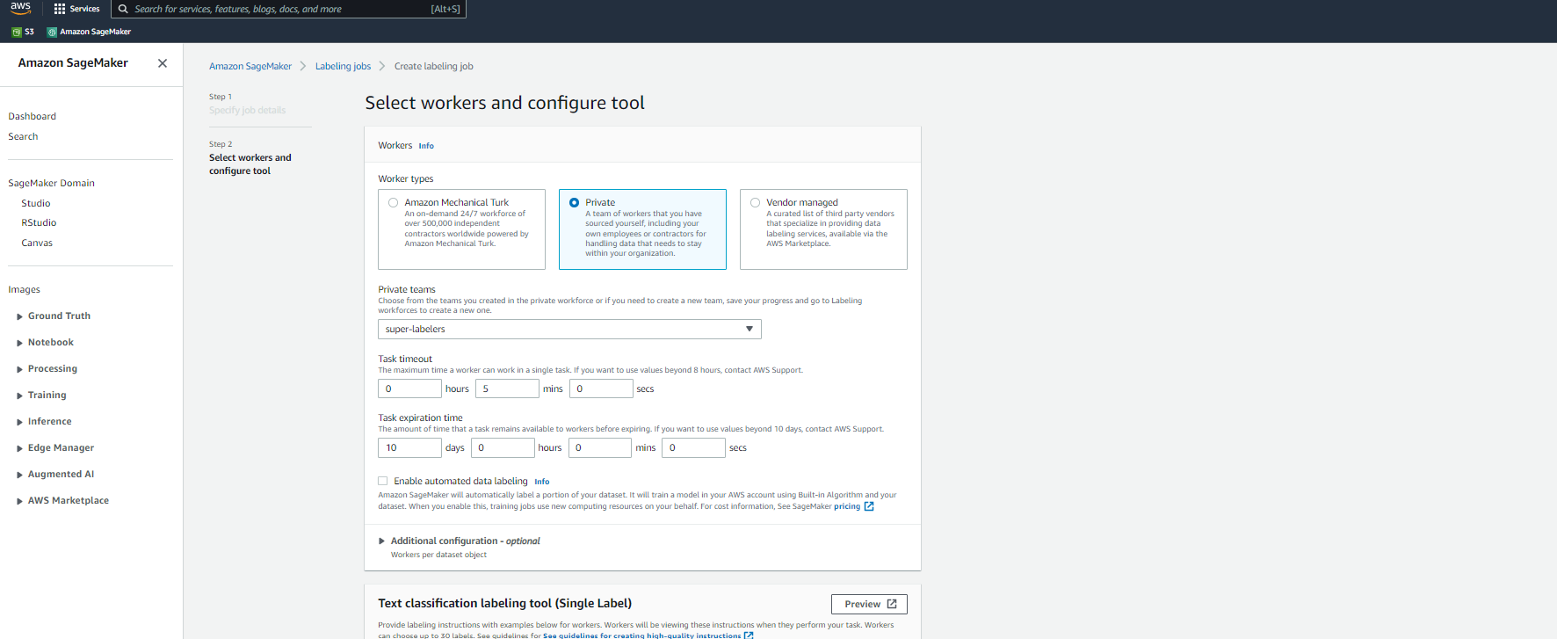
LABELING TEXT DATASET
CHOOSE PRIVATE AND SELECT YOUR TEAM

Slide 12
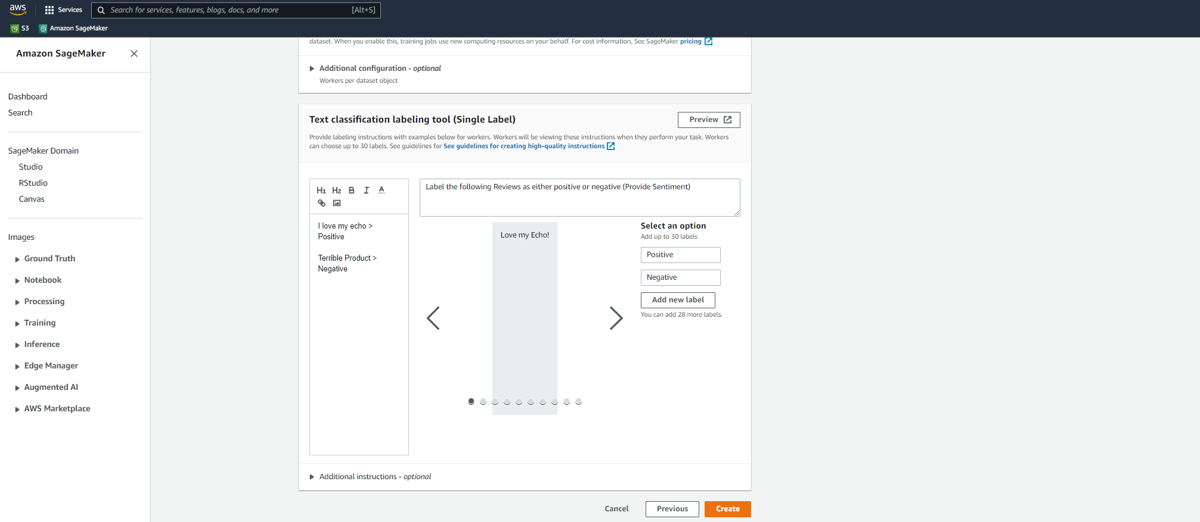
LABELING TEXT DATASET
PROVIDE GUIDANCE TO THE LABELING TEAM. CLICK PREVIEW TO SEE THE LABELING JOB!

Slide 13
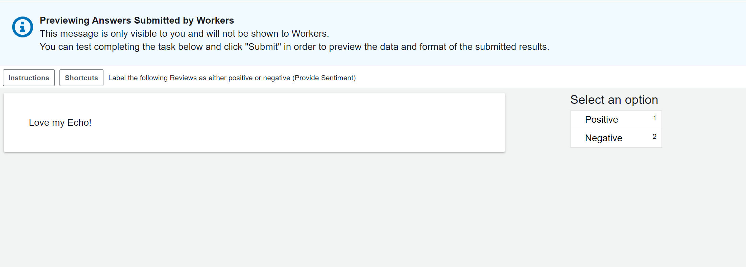
LABELING TEXT DATASET
VIEW OF THE LABELING JOB!

Slide 14
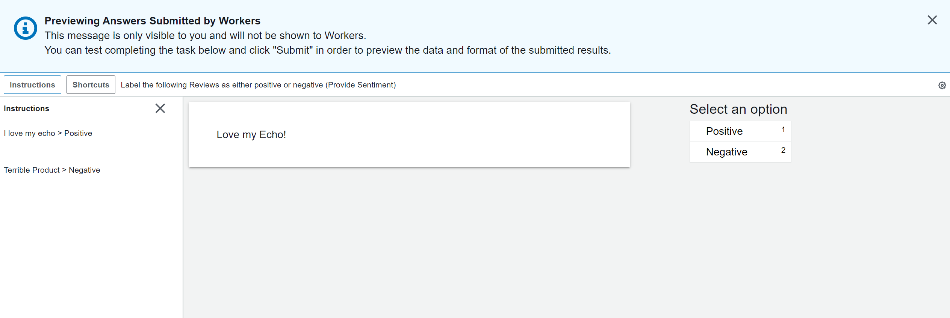
LABELING TEXT DATASET
CLICK ON INSTRUCTIONS. CLICK ON CREATE LABELING JOB ONCE YOU MADE SURE EVERYTHING LOOKS GOOD!

Slide 15
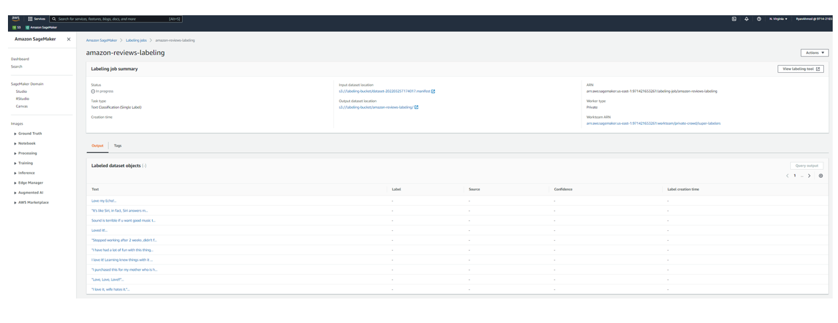
LABELING TEXT DATASET
CHECK OUT THE LABELING JOB DETAILS

Slide 16
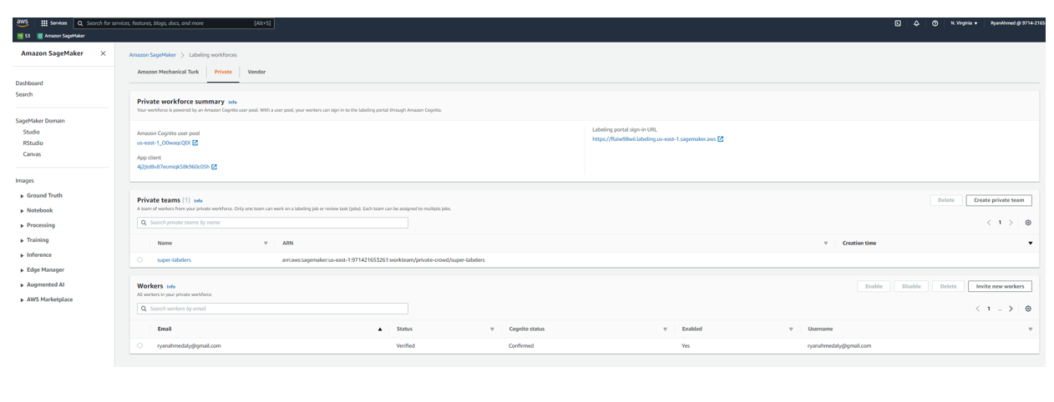
LABELING TEXT DATASET
NAVIGATE TO LABELING WORKFORCE AND INVITE TEAM MEMBERS

Slide 17
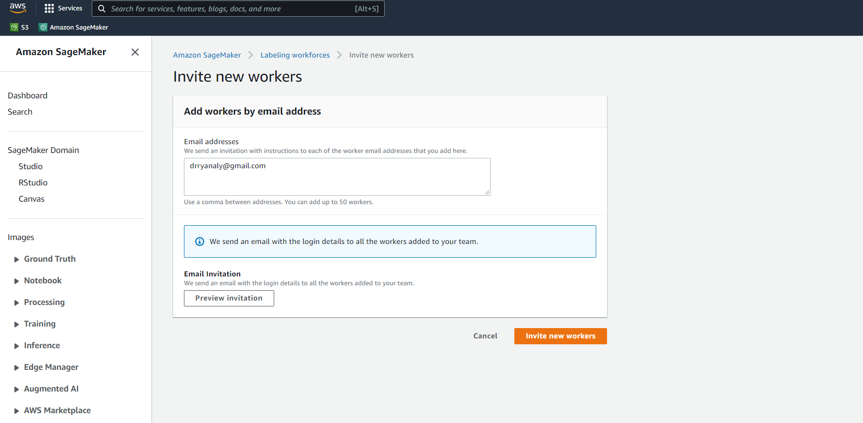
LABELING TEXT DATASET
ENTER THE EMAIL OF THE WORKER AND CLICK ON INVITE NEW WORKER

Slide 18
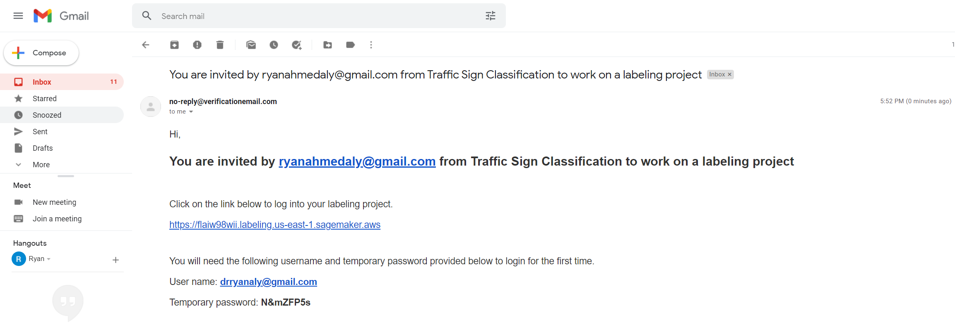
LABELING TEXT DATASET
YOU WILL RECEIVE THE FOLLOWING EMAIL, LOGIN WITH THE PROVIDED USERNAME AND PASSWORD

Slide 19
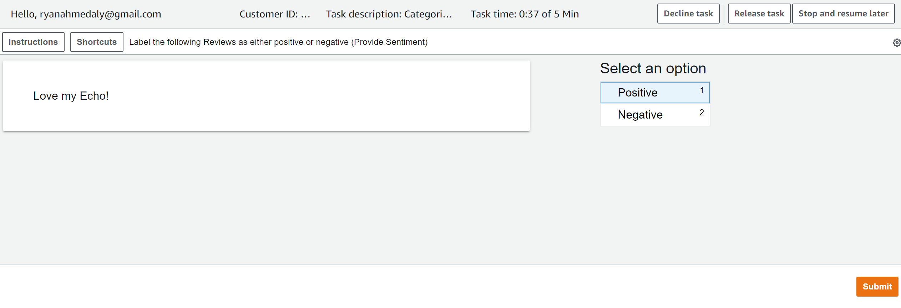
LABELING TEXT DATASET
START LABELING! HAVE FUN! THIS REVIEW IS POSITIVE

Slide 20
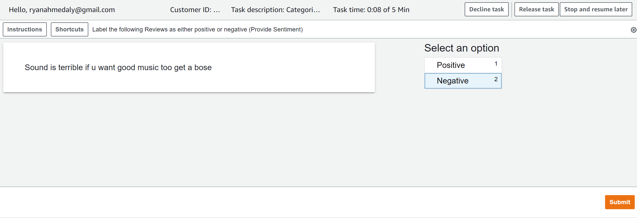
LABELING TEXT DATASET
THIS REVIEW IS NEGATIVE

Slide 21
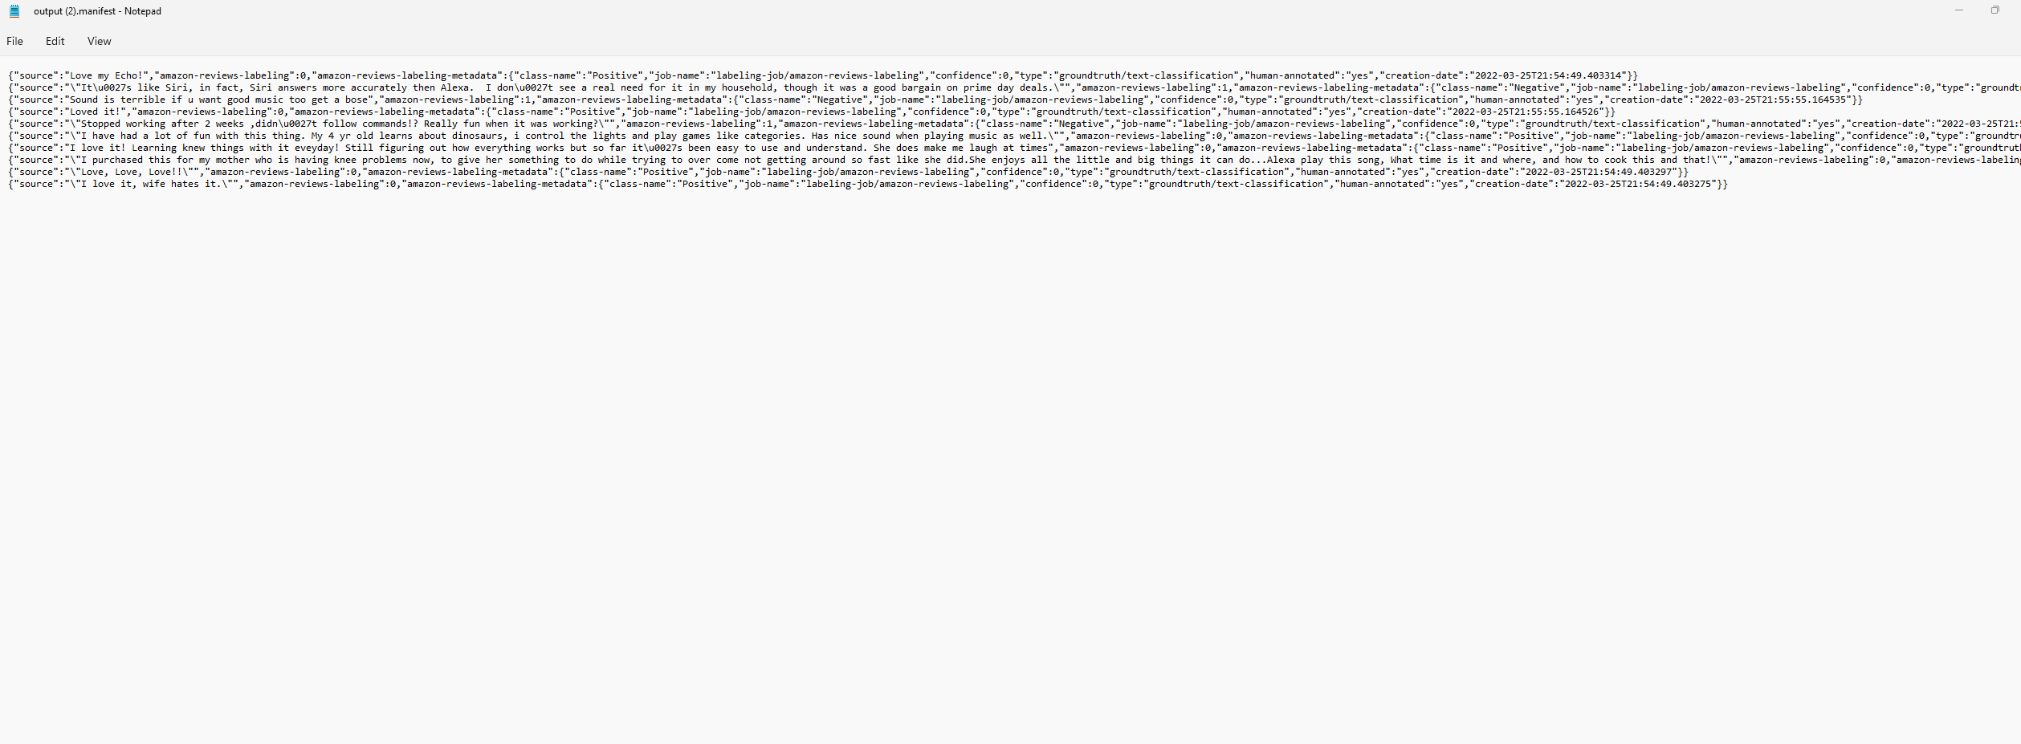
LABELING TEXT DATASET
REVIEW THE OUTPUT MANIFEST FILE

Slide 22
LABELING TEXT DATASET
CHECK THE STATUS OF THE LABELING JOB

Slide 23
LABELING IMAGES: SEMANTIC SEGMENTATION
EASY
ADVANCED

Slide 24
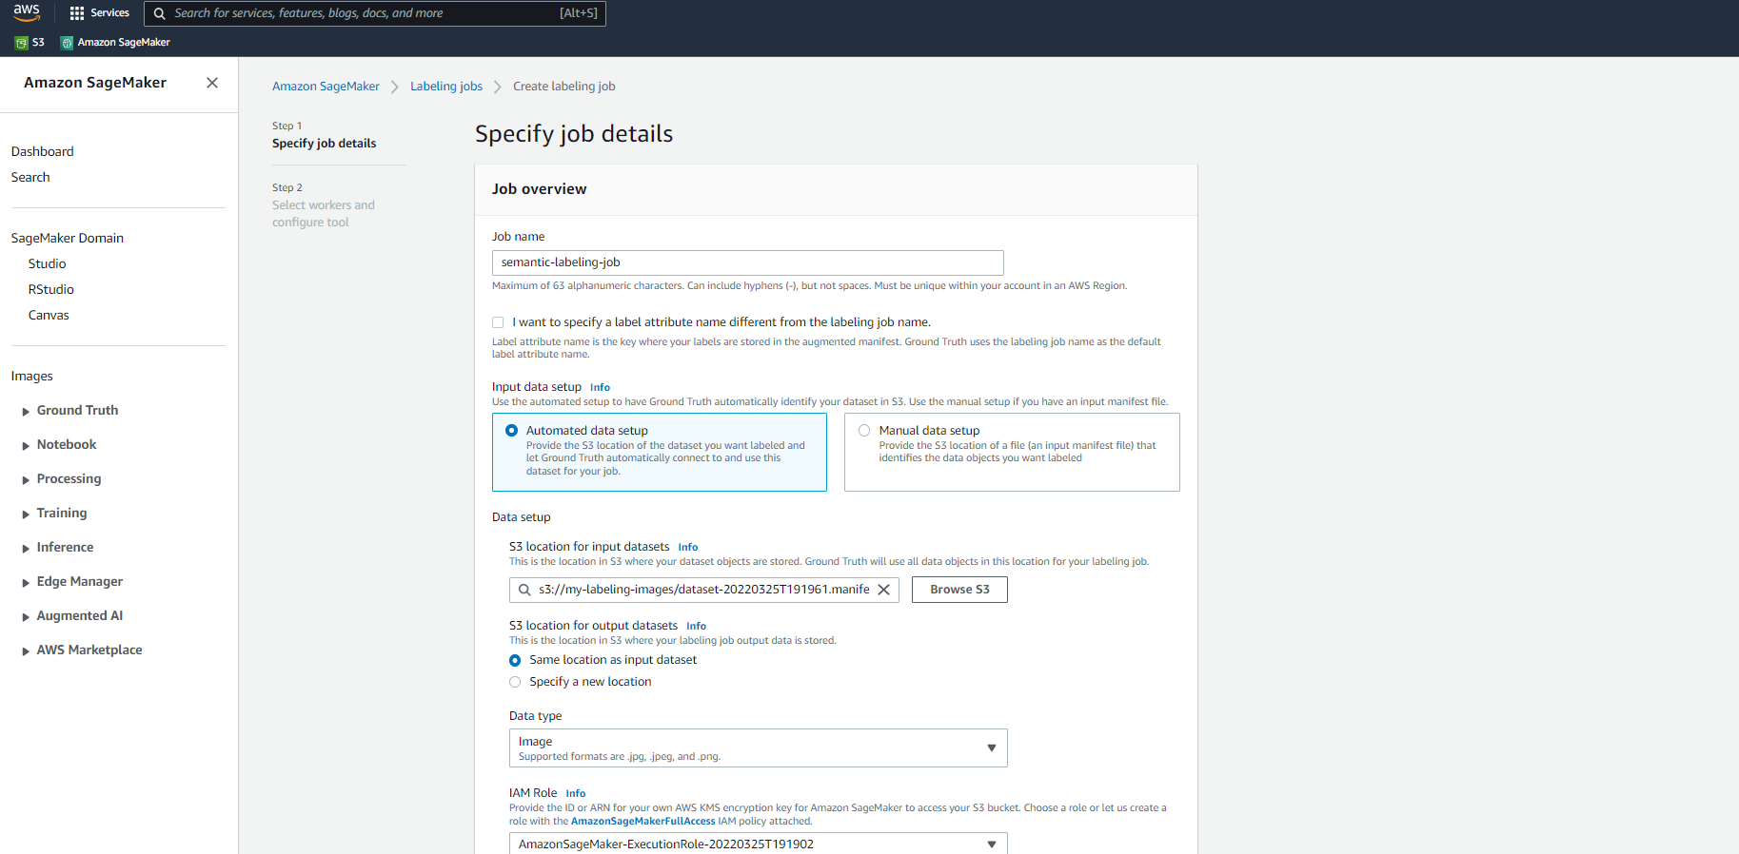
LABELING IMAGES: SEMANTIC SEGMENTATION
LET’S CREATE A SEMANTIC SEGMENTATION JOB

Slide 25
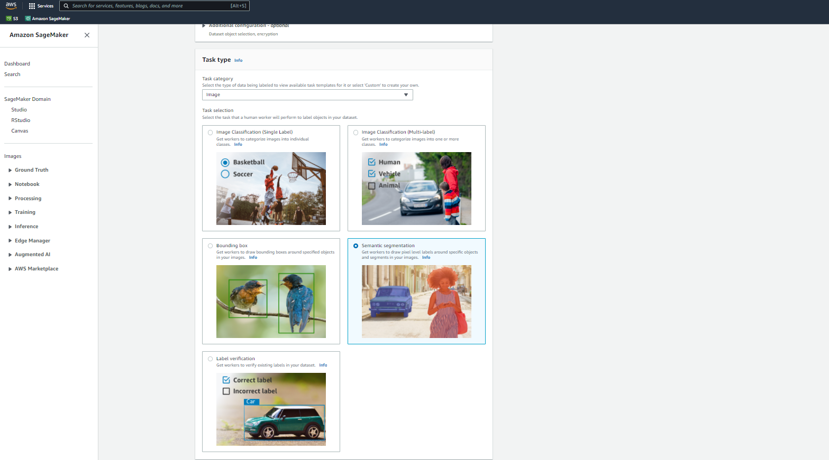
LABELING IMAGES: SEMANTIC SEGMENTATION
BOUNDING BOXES LABELING JOB IS NOW COMPLETE

Slide 26
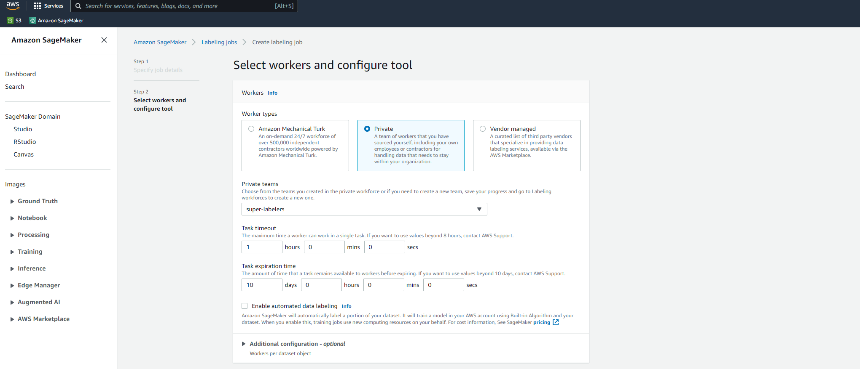
LABELING IMAGES: SEMANTIC SEGMENTATION
CHOOSE THE TEAM

Slide 27
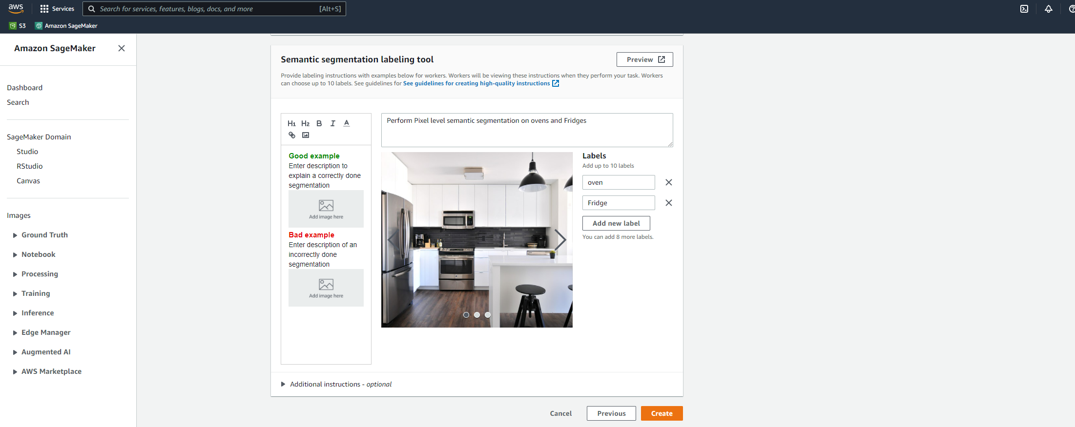
LABELING IMAGES: SEMANTIC SEGMENTATION
PROVIDE INSTRUCTIONS!

Slide 28
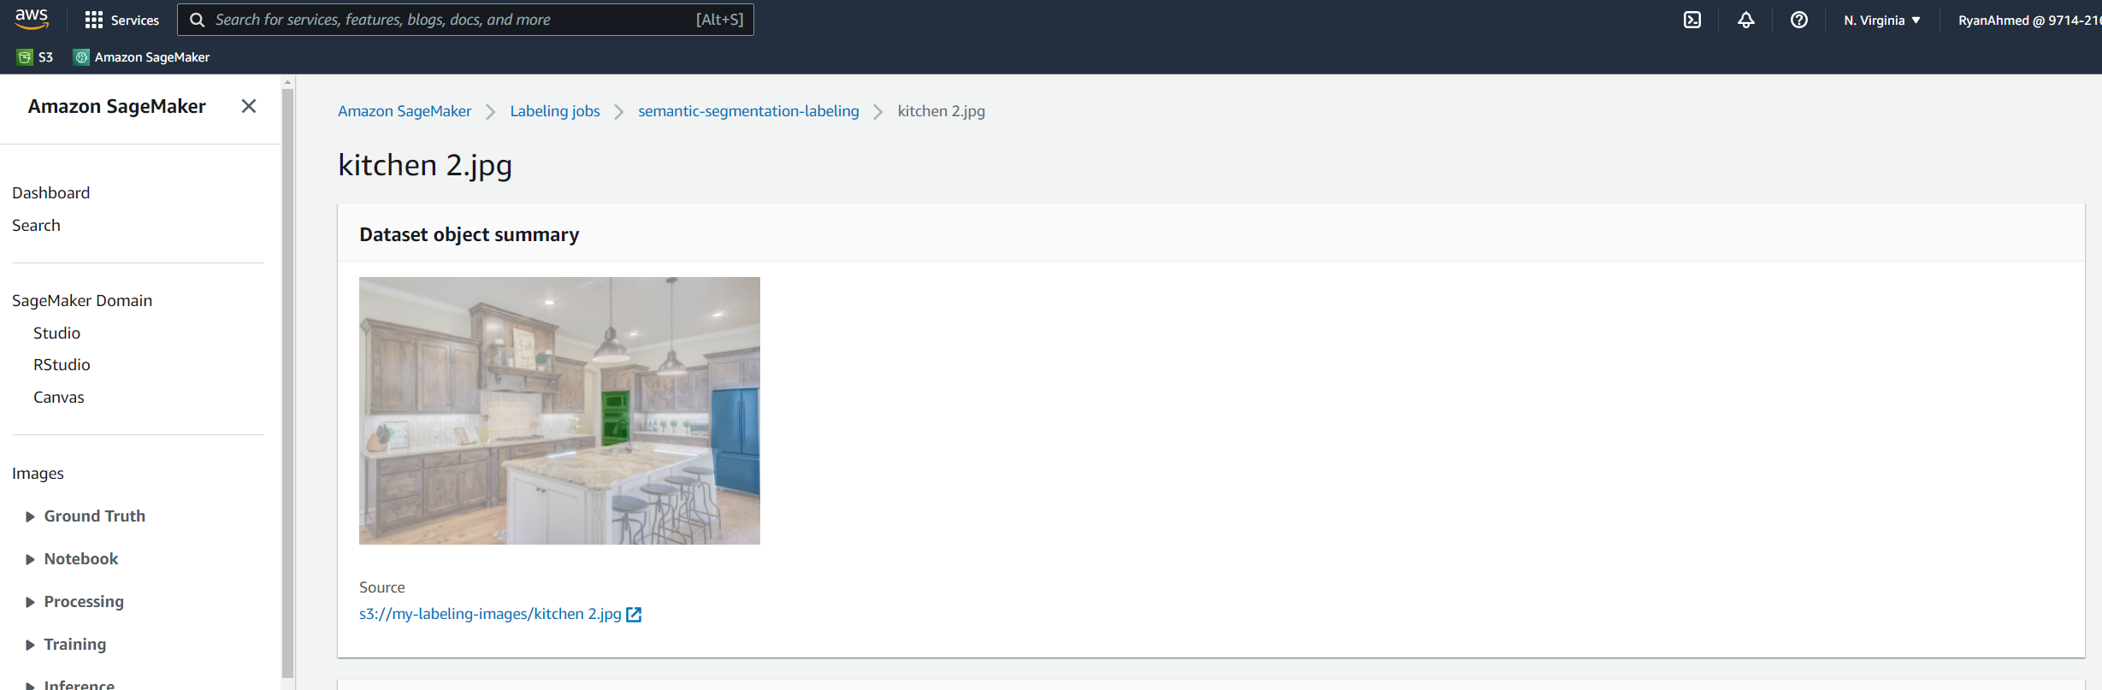
LABELING IMAGES: SEMANTIC SEGMENTATION
SELECT FRIDGE AND OVEN FROM THE IMAGES

Slide 29
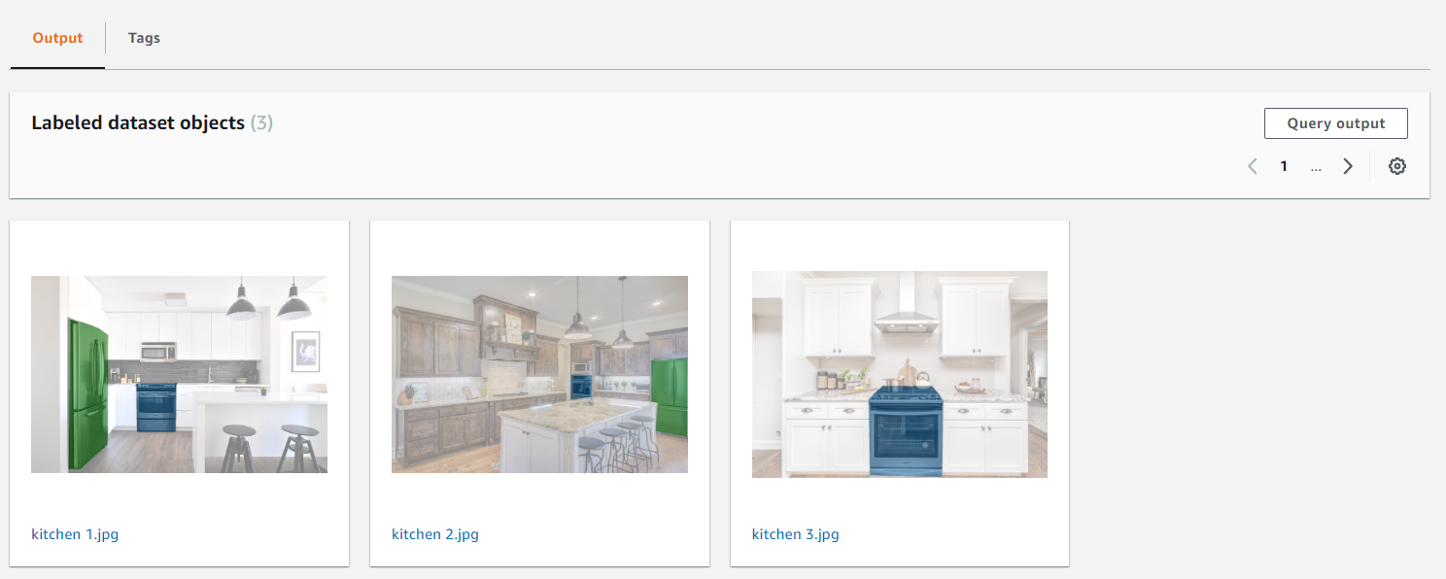
LABELING IMAGES: SEMANTIC SEGMENTATION
LABELING JOB IS COMPLETE

Slide 30
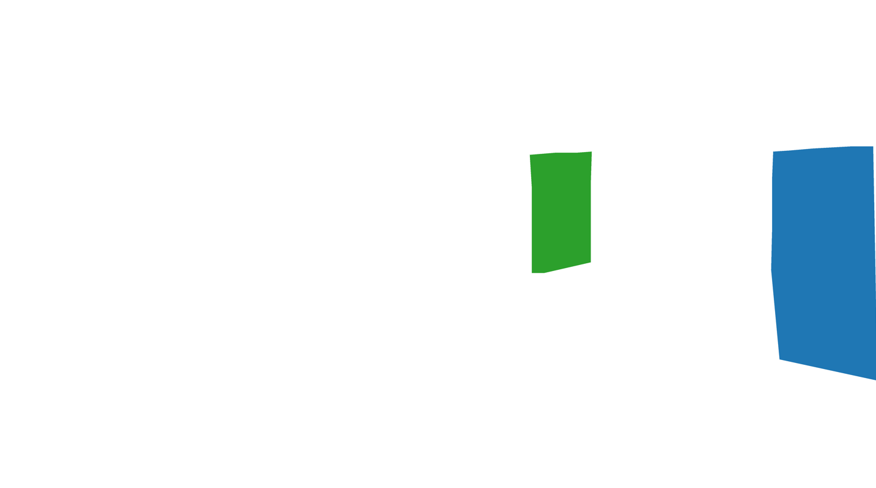
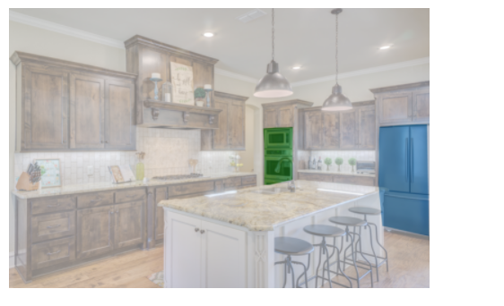
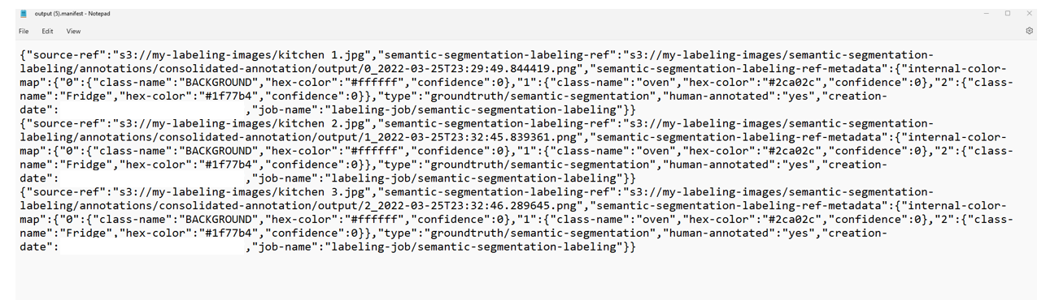
LABELING IMAGES: SEMANTIC SEGMENTATION
THE OUTPUT IS THE MANIFEST FILE ALONG WITH AN IMAGE CONTINAINING PIXEL LEVEL SEGMENTATION (WITH COLOR CODE THAT INDICATES THE CLASS)

Slide 31
GROUNDTRUTH PRICING
EASY
ADVANCED

Slide 32
PRICING OF SAGEMAKER GROUNDTRUTH
AWS Free Tier: For first two month, 500 objects labeled per month are free.
Customers pay for each labeled object (image, audio, text) whether it’s labeled automatically by SageMaker Ground Truth (autolabeling) or by humans.
If Mechanical Turks or third-party vendors are used, an additional cost is added per labeled object.
If customers leverage their own internal employees, no additional cost per labeled object is required.
REVIEWED OBJECTS (IMAGES, VIDEO FRAMES, TEXT, AUDIO FILES, ETC.)
NUMBER OF REVIEWED OBJECTS PER MONTH | PRICE PER REVIEWED OBJECT
Less than 50,000 objects | $0.08
50,000 to 1,000,000 objects | $0.04
Greater than 1,000,000 objects | $0.02

Slide 33
PRICING OF SAGEMAKER GROUNDTRUTH
If Amazon Mechanical Turks are used for labeling, there is an additional charge per object per review instance.
Multiple labelers per object are recommended to enhance the accuracy of the labels.
WORKFLOW | SUGGESTED PRICE PER LABELER
Image classification | $0.012
Text classification | $0.012
Named Entity Recognition (NER) | $0.024
Bounding box | $0.036
Semantic Segmentation | $0.84

Slide 34
PRICING OF SAGEMAKER GROUNDTRUTH: EXAMPLE #1
QUESTION
Let’s assume we have a company that is leveraging its own internal employees to label images.
The total number of images they labeled is 40,000 images.
The company uses Amazon SageMaker Groundtruth to manage the labeling process.
Calculate the estimated cost of the labeling process.
SOLUTION
Since the company used its own workforce and since the number of images is below 50,000. Then the cost of each image is $0.08.
Total Cost = 40,000 human-labeled images x $0.08 per image = $3,200
AWS SageMaker Pricing Examples: https://aws.amazon.com/sagemaker/data-labeling/pricing/?nc=sn&loc=3&refid=ps_a134p0000078pqxaae&trkcampaign=acq_paid_search_brand

Slide 35
PRICING OF SAGEMAKER GROUNDTRUTH: EXAMPLE #2
QUESTION
A company want to label 85,000 posts (text data) using Amazon SageMaker GroundTruth.
The company set a custom workflow and set a payment of $0.036 per post.
The company decided to label each post three times to improve the accuracy.
Because the company used Mechanical Turk, the cost includes an additional charge of $0.036 for each human-labeled post to pay the labeler.
SOLUTION
Note that the first
Total Cost = (50,000 x $0.08 per article) + (35,000 posts x $0.04 per post) + (85,000 human-labeled posts x $0.036 per post x 3 labelers per object) = $14,580
AWS SageMaker Pricing Examples: https://aws.amazon.com/sagemaker/data-labeling/pricing/?nc=sn&loc=3&refid=ps_a134p0000078pqxaae&trkcampaign=acq_paid_search_brand

Slide 36
GROUNDTRUTH PRICING PRACTICE OPPORTUNITY
EASY
ADVANCED

Slide 37
PRACTICE OPPORTUNITY
QUESTION
A publishing company wants to natural language processing application to classify newspaper articles. To do this, they want to label 200,000 articles.
Each article need to be labeled three times.
Using SageMaker Ground Truth, humans label 40,000 articles and 160,000 are labeled automatically.
Because the company used Mechanical Turk, the text classification workflow included an additional charge of $0.012 for each human-labeled article to pay the labeler.
AWS SageMaker Pricing Examples: https://aws.amazon.com/sagemaker/data-labeling/pricing/?nc=sn&loc=3&refid=ps_a134p0000078pqxaae&trkcampaign=acq_paid_search_brand

Slide 38
PRACTICE OPPORTUNITY
SOLUTION
Total Cost = (50,000 x $0.08 per article) + (150,000 articles x $0.04 per article) + (40,000 human-labeled articles x $0.012 per article x 3 labelers per object) + Amazon SageMaker training & inference costs** = $11,440 + Amazon SageMaker training & inference costs**
**These costs depend on a variety of factors, including the type of dataset being used, the type of labeling task, and the resolution of the images in your dataset.
AWS SageMaker Pricing Examples: https://aws.amazon.com/sagemaker/data-labeling/pricing/?nc=sn&loc=3&refid=ps_a134p0000078pqxaae&trkcampaign=acq_paid_search_brand

Slide 39
FINAL END-OF-DAY CAPSTONE PROJECT
EASY
ADVANCED

Slide 40
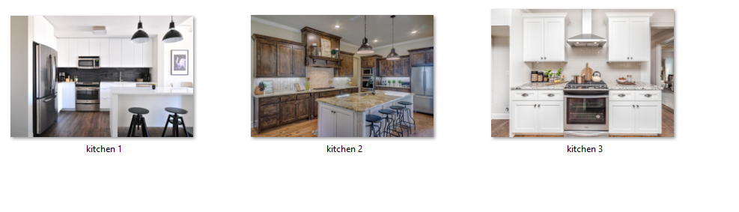
PROJECT
Using the 3 kitchen images included in the course package.
Create a bounding box labeling job using Amazon SageMaker GroundTruth to label only the “fridge” and “oven”.
Review the input manifest file.
Perform the labeling job.
Review the output manifest file and ensure that the labeling job was successful.

Slide 41
FINAL END-OF-DAY CAPSTONE PROJECT SOLUTION
EASY
ADVANCED

Slide 42

LABELING IMAGES WITH BOUNDING BOXES
UPLOAD THE IMAGES TO S3 BUCKET

Slide 43
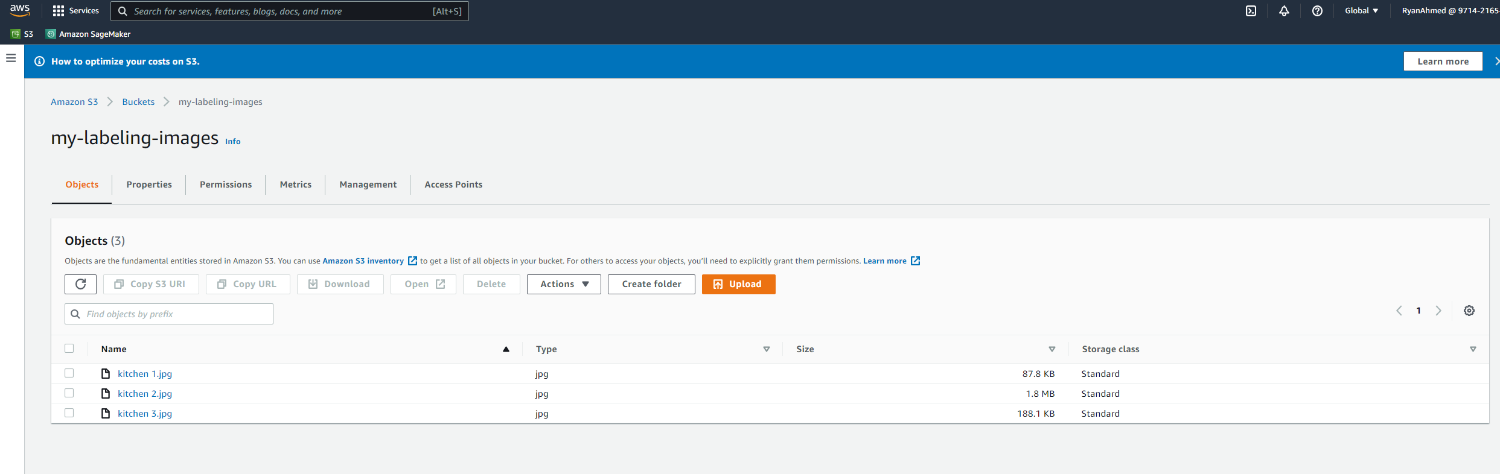
LABELING IMAGES WITH BOUNDING BOXES
UPLOAD IMAGES

Slide 44
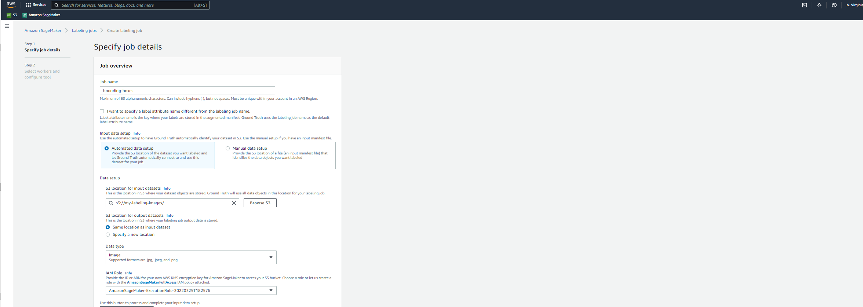
LABELING IMAGES WITH BOUNDING BOXES
CREATE A LABELING JOB. DON’T FORGET TO CLICK ON COMPLETE DATA SETUP TO GENERATE THE MANIFEST FILE

Slide 45
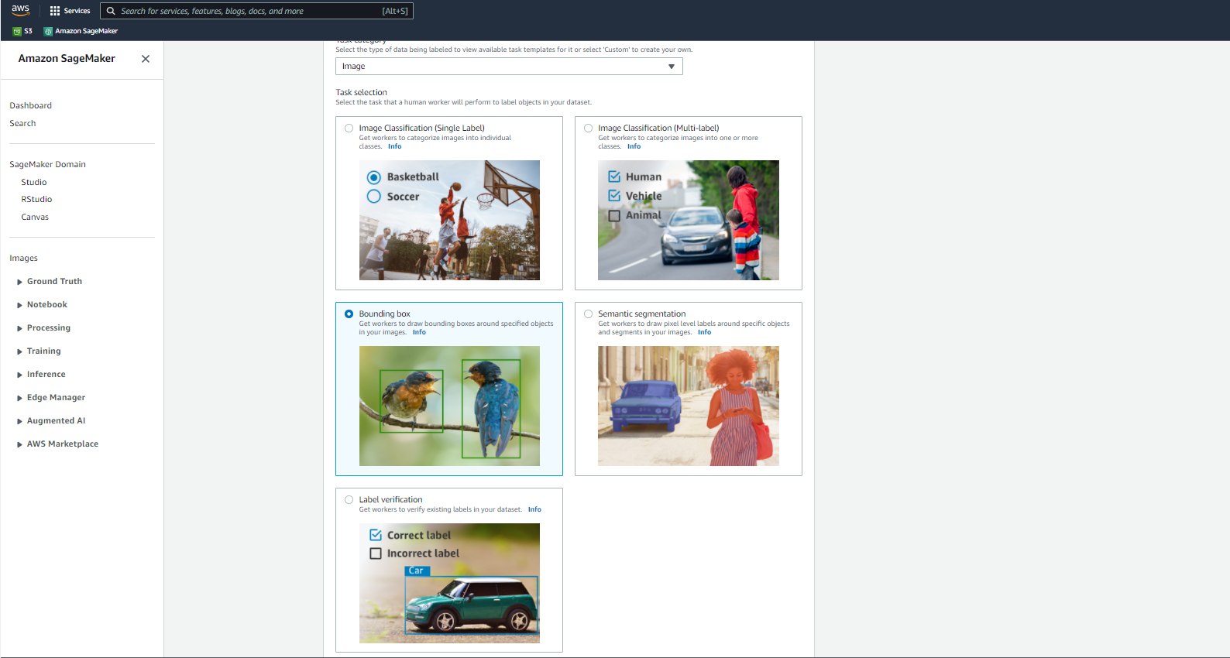
LABELING IMAGES WITH BOUNDING BOXES
SELECT THE BOUNDING BOX OPTION AND CLICK NEXT

Slide 46
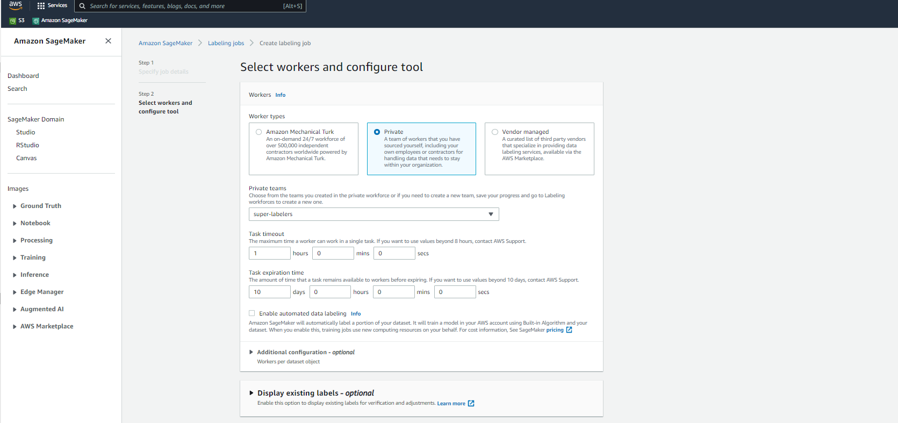
LABELING IMAGES WITH BOUNDING BOXES
SELECT PRIVATE AND CHOOSE SUPER-LABELERS

Slide 47
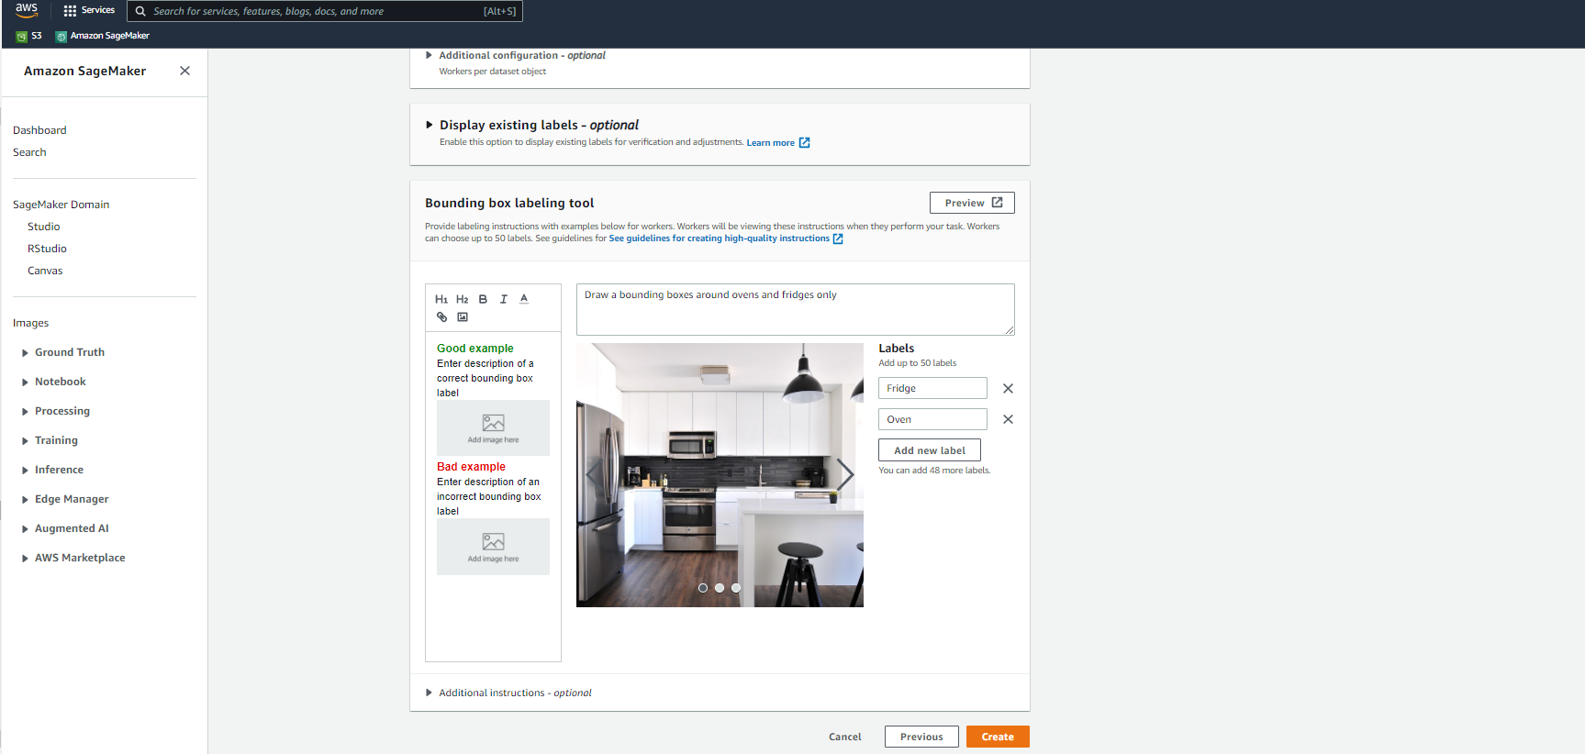
LABELING IMAGES WITH BOUNDING BOXES
PROVIDE INSTRUCTIONS AND CLICK CREATE!

Slide 48
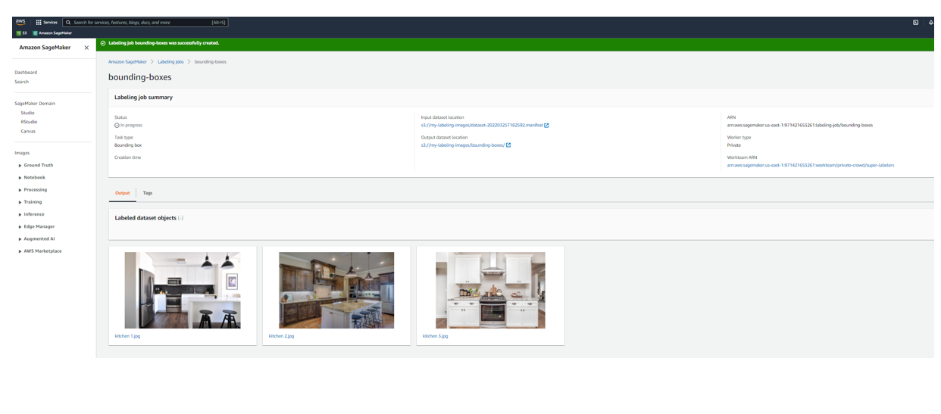
LABELING IMAGES WITH BOUNDING BOXES
REVIEW THE LABELING JOB HERE!

Slide 49
LABELING IMAGES WITH BOUNDING BOXES
LABEL THE FRIDGE AND OVEN

Slide 50
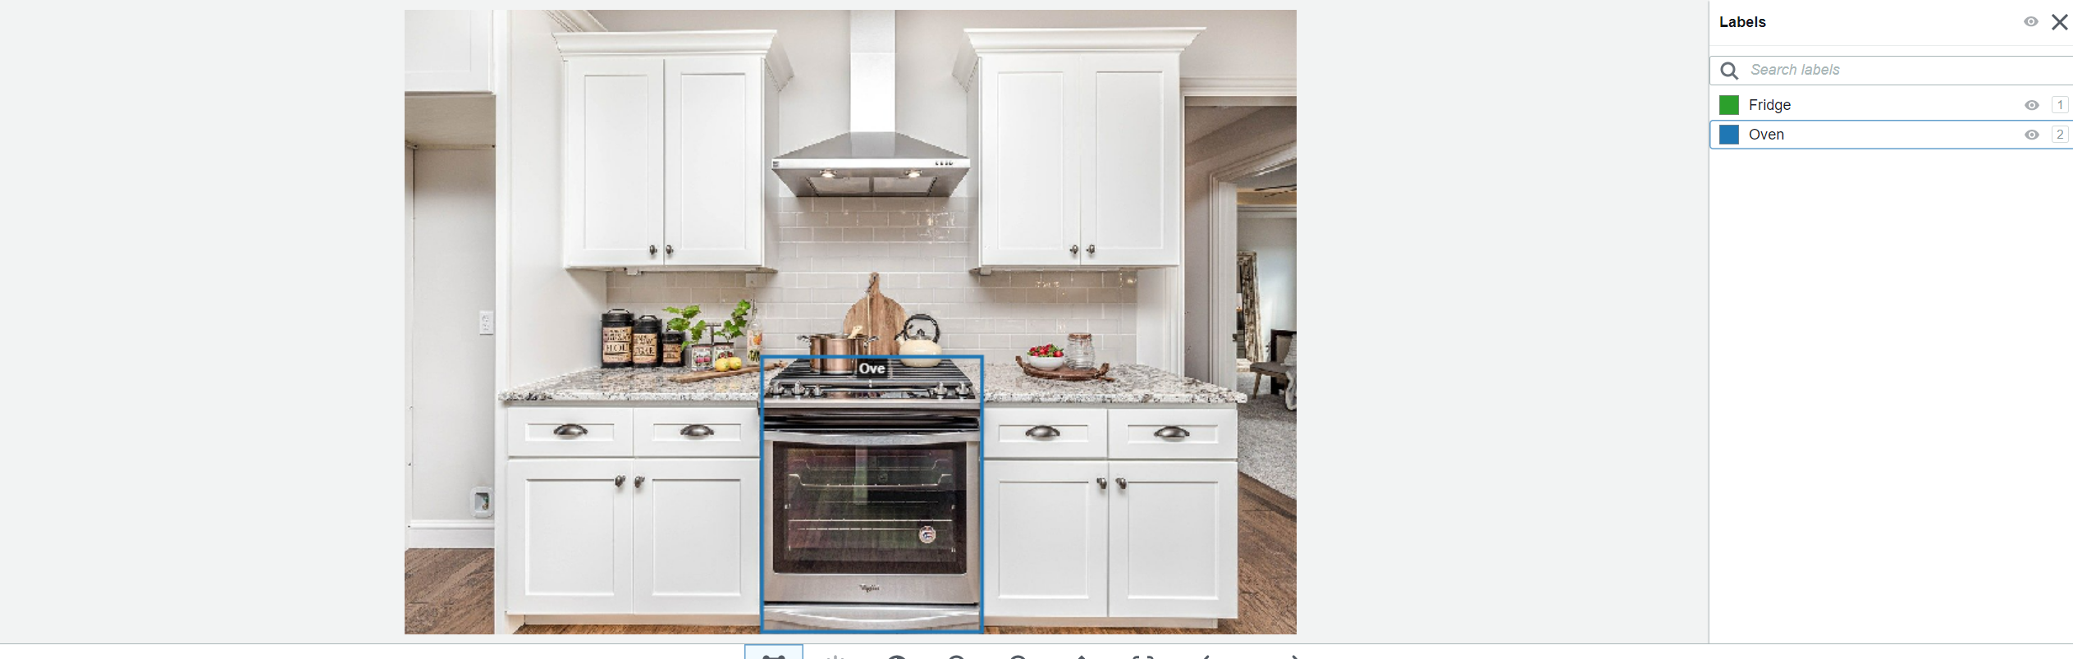
LABELING IMAGES WITH BOUNDING BOXES
LABEL THE OVEN IN THE IMAGE

Slide 51
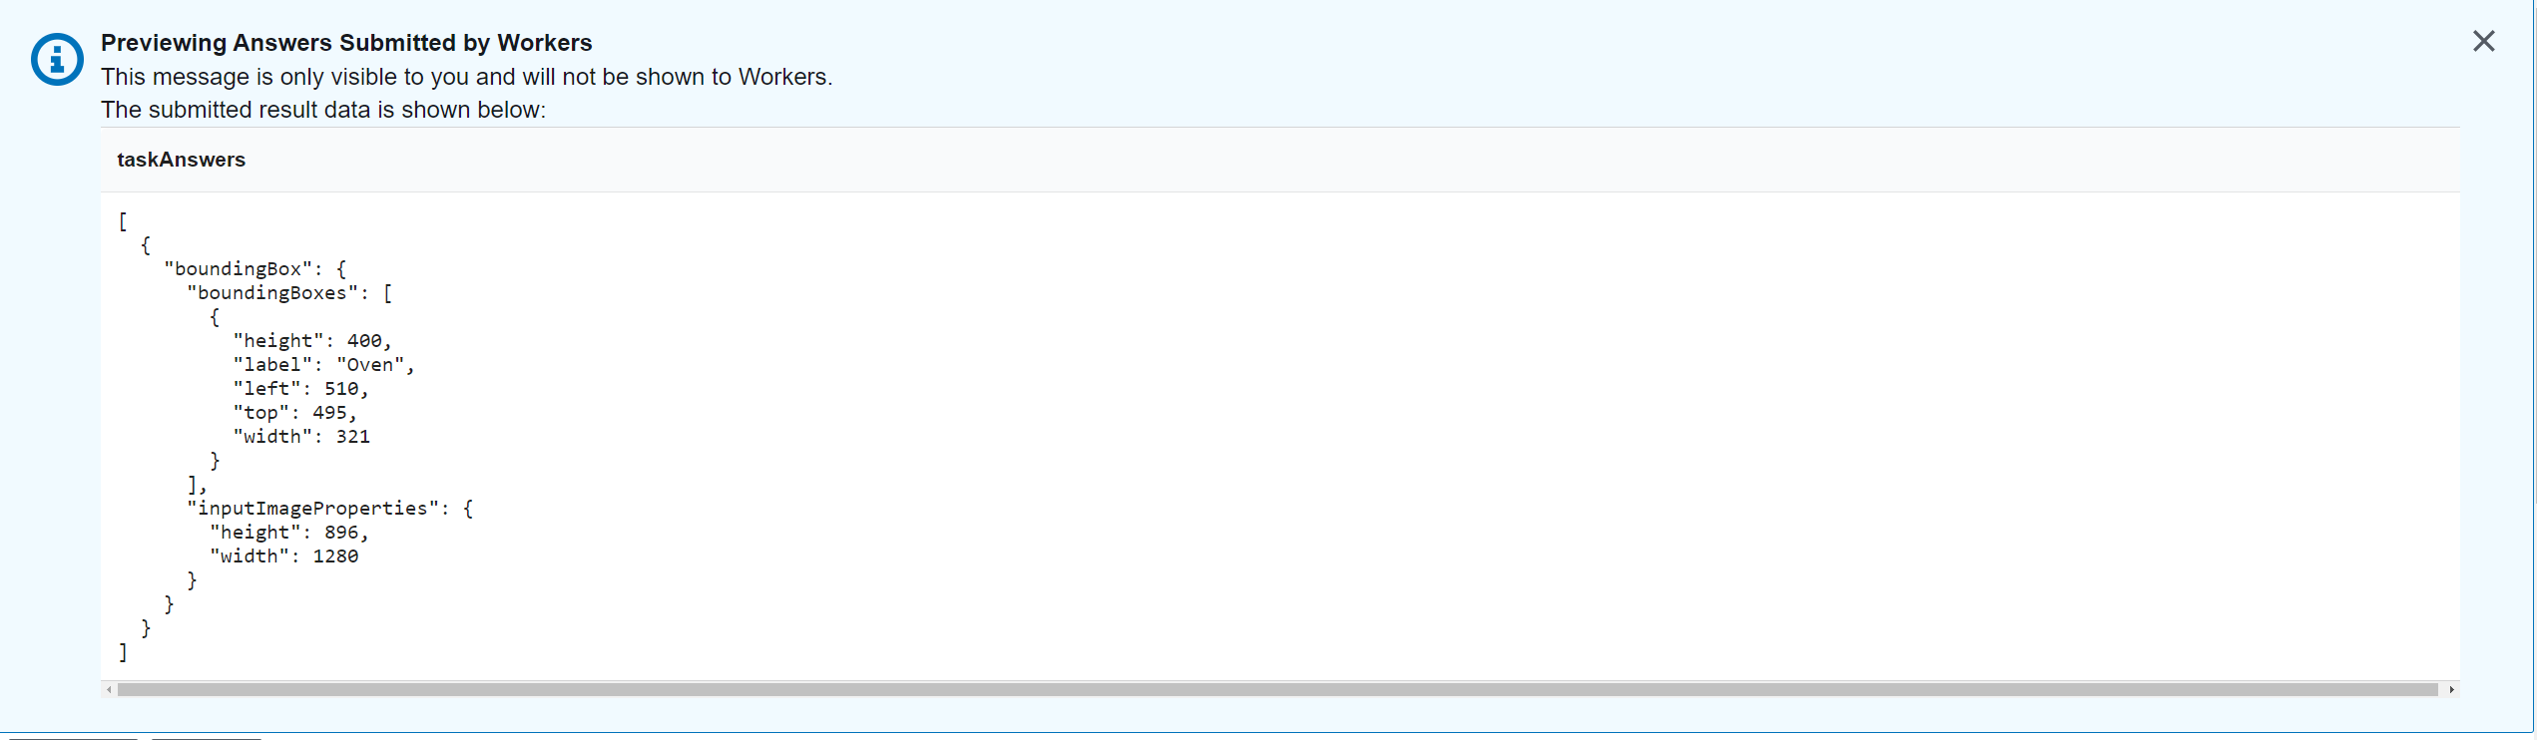
LABELING IMAGES WITH BOUNDING BOXES
COORDINATES OF THE BOUNDING BOXES

Slide 52
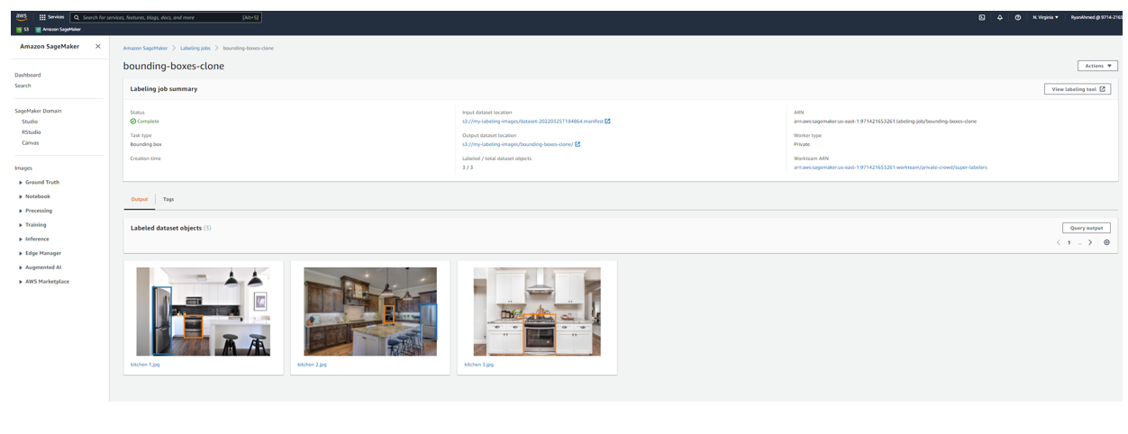
LABELING IMAGES WITH BOUNDING BOXES
BOUNDING BOXES LABELING JOB IS NOW COMPLETE

Slide 53
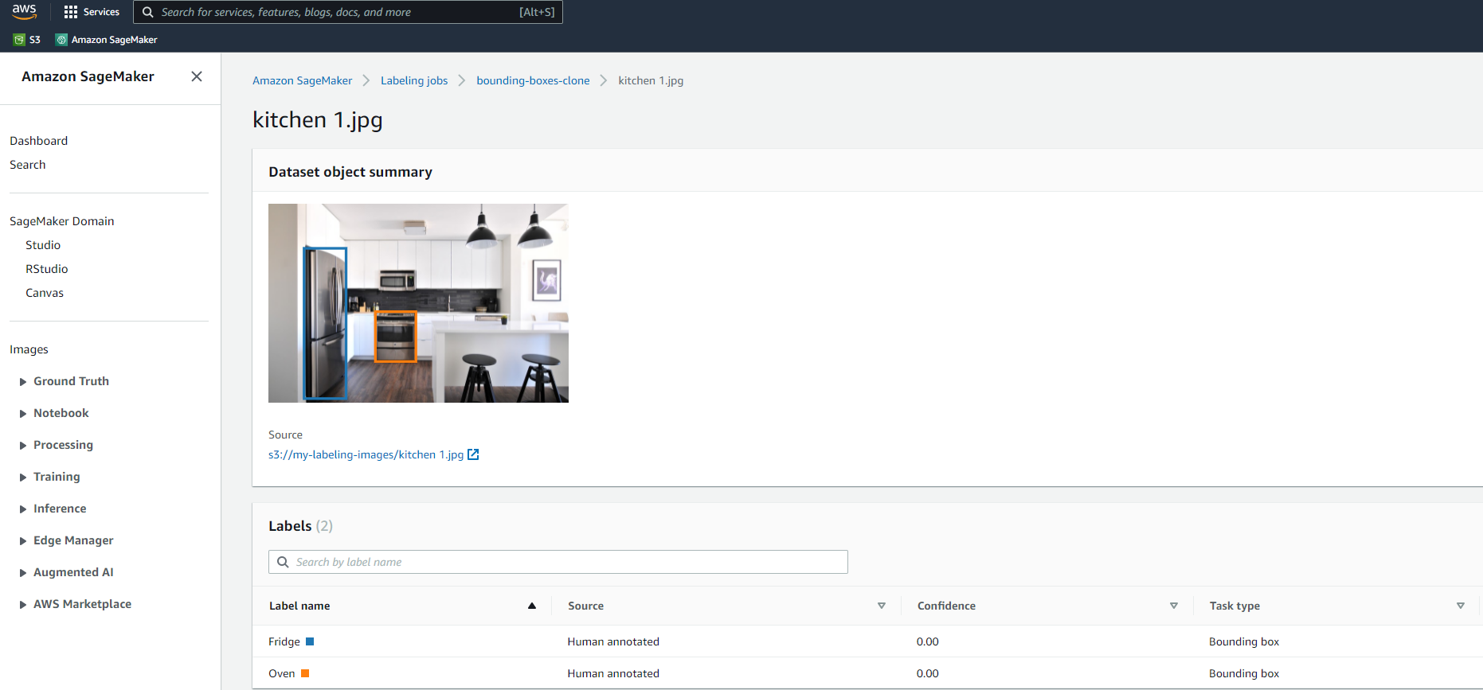
LABELING IMAGES WITH BOUNDING BOXES
SELECT A SAMPLE IMAGE TO REVIEW THE RESULTING LABEL

Slide 54
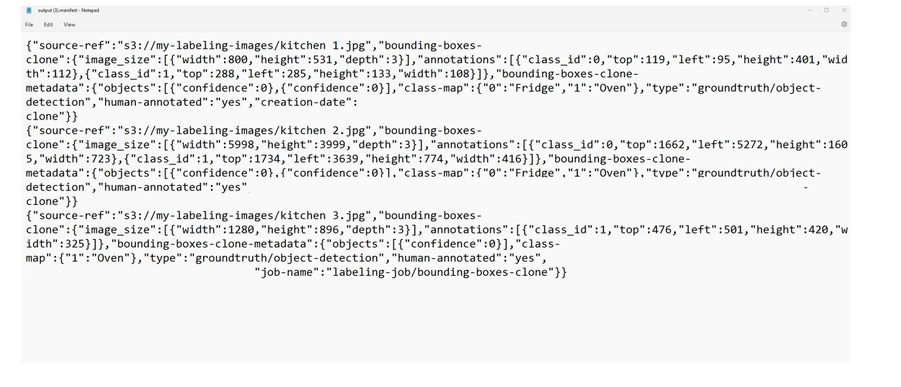
LABELING IMAGES WITH BOUNDING BOXES
OUTPUT MANIFEST FILE

